Slide 1




Udemy Clone Application
A Personalized Learning Platform
Name: Jenil Girish Rathod
Roll No.: T212009 Div: B Class: T.E.
College: Zeal College Of Engineering and Research

Slide 2
Introduction
Welcome to Udemy Clone Application
A personal learning where users can:
  Register and create accounts
  Login and access courses
  Browse and purchase courses
  Add reviews for completed courses
  Track and manage purchased courses

Slide 3
Features of the Application
User Registration & Login
Course Viewing & Purchase
Review and Ratings
Secure Payment Options
User Dashboard

Slide 4
Technologies Used
Programming Language: Java
Database Management: MySQL, JDBC (Java Database Connectivity)
User Input Handling: Scanner Class
Object-Oriented Concepts:
  Encapsulation, Inheritance, Polymorphism, Abstraction
Design Patterns:
  Singleton Pattern (Database Connection)
  Factory Pattern (Can be applied for object creation)
Security Considerations:
  Password hashing for authentication
  Use of Prepared Statements to prevent SQL Injection

Slide 5
Code Structure Overview
Main Class: UdemyCloneApp
Other Classes:
  User (Handles registration, login, and user data)
  Course (Displays courses and manages purchases)
  Review (Handles reviews and ratings)
  Database (Stores data)
  PaymentProcessor (Handles payments)

Slide 6
Class Structure Overview
1. UdemyCloneApp (Main Class)
  Manages the main menu and user interactions.
  Handles user registration, login, and course browsing.
2. UserBase (Abstract Class)
  Defines base attributes for users.
  Contains common user-related methods.
3. User (Extends UserBase)
  Stores user details (ID, name, email, password).
  Manages registration, login, and course tracking.
  Interacts with the Database class for user authentication.
4. Course
  Stores course details (ID, title, domain, description, price, rating).
  Displays course information.
  Handles course purchases.
5. Review
  Allows users to add and view course reviews.
  Stores review details in the database.
6. Payment (Interface)
  Defines the processPayment() method for different payment types.
7. PaymentProcessor (Implements Payment)
  Handles course payment transactions.
  Manages payment methods and discounts.
8. Discount
  Retrieves applicable discount values from the database.
  Validates coupon codes.
9. Database
  Handles database connections and SQL queries.
  Provides methods for inserting, updating, selecting, and deleting records.

Slide 7
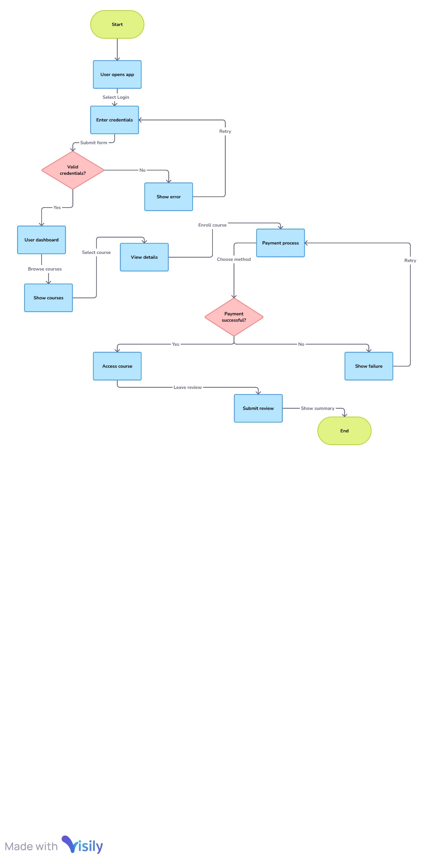
Class Diagram

Slide 8
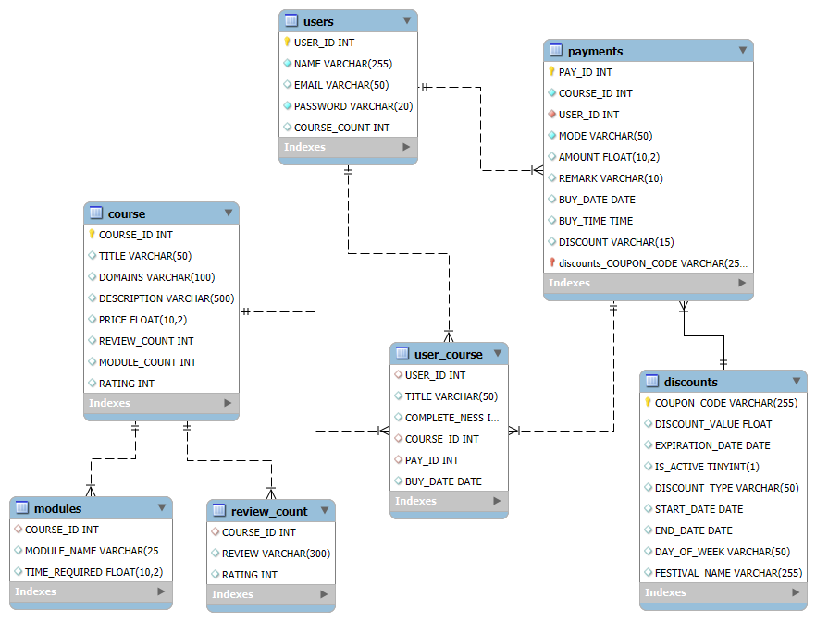
ER Diagram
Notes:
When conducting research, it is easy to go to one source: Wikipedia. However, you need to include a variety of sources in your research. Consider the following sources:
Who can I interview to get more information on the topic?
Is the topic current and will it be relevant to my audience?
What articles, blogs, and magazines may have something related to my topic?
Is there a YouTube video on the topic? If so, what is it about?
What images can I find related to the topic?

Slide 9
Future Enhancements
Mobile App Integration: Expand to mobile platforms for better accessibility.
Real-time Notifications: Push notifications for updates and promotions.
AI-Powered Recommendations: Personalized course suggestions.
Advanced Payment Options: Support for multiple payment methods and cryptocurrencies.
Live Classes & Webinars: Real-time streaming of classes and sessions.
Gamification: Badges, achievements, and leaderboards.
Multi-language Support: Global reach with multi-language options.
Social Learning: Forums, groups, and peer interaction.
Subscription Model: Unlimited access via subscription.
AI-assisted Course Creation: Tools for instructors to generate content.
Notes:
Once you find your sources, you will want to evaluate your sources using the following questions:
Author:
Who is the author?
Why should I believe what he or she has to say on the topic?
Is the author seen as an expert on the topic? How do you know?
Current:
How current is the information in the source?
When was the source published?
Is the information out-of-date?
Accuracy:
Is the content accurate?
Is the information presented objectively? Do they share the pros and cons?

Slide 10


